Slide 1
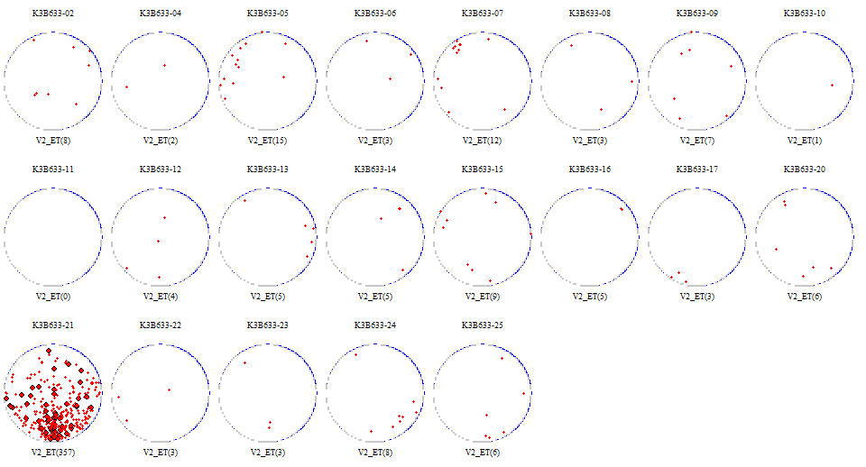
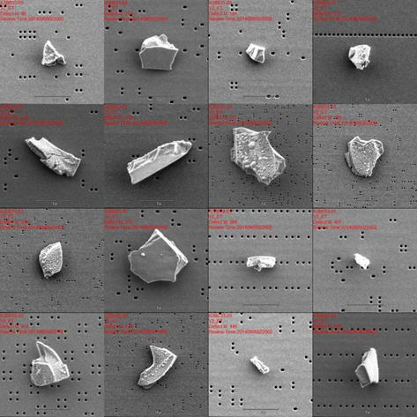
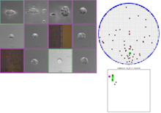
Case 9: F8 Vx ET Pin arcing
Issue Description:
Vx ET suffer Pin arcing defect. (surface type)
IEMS&DA can not getting.
Root Cause:
Not clear, suspect PIN position NG
Containment Actions:
Survey install 2 stage lift PIN follow WW

Slide 2
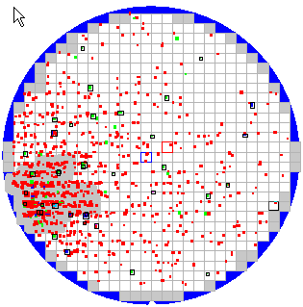
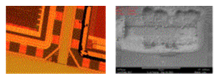

Case 10: S1 D13 DRM Via Arcing
Issue description:
V*OX_ET baseline suffer random arcing issue at wafer edge
Root cause:
When F/R is higher, an electron loses by F/R. The number of the electrons supplied to wafer Edge decreases.
When F/R is thin, The number of the electrons supplied to wafer Edge increase ➔ Electric potential of metal layer in edge area is change, voltage between plasma and wafer increase. ➔ Possible an outbreak of arcing
Solution:
Tighten F-ring lifetime from 300RF (2 PM cycle) to 150RF (1 PM cycle)
Magnetic line
Wafer
F-Ring
ESC
New F-Ring(Thickness=3.4mm)
Magnetic line
Wafer
F-Ring
ESC
Old F-Ring(Thickness=2.8mm)

Slide 3
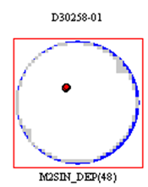
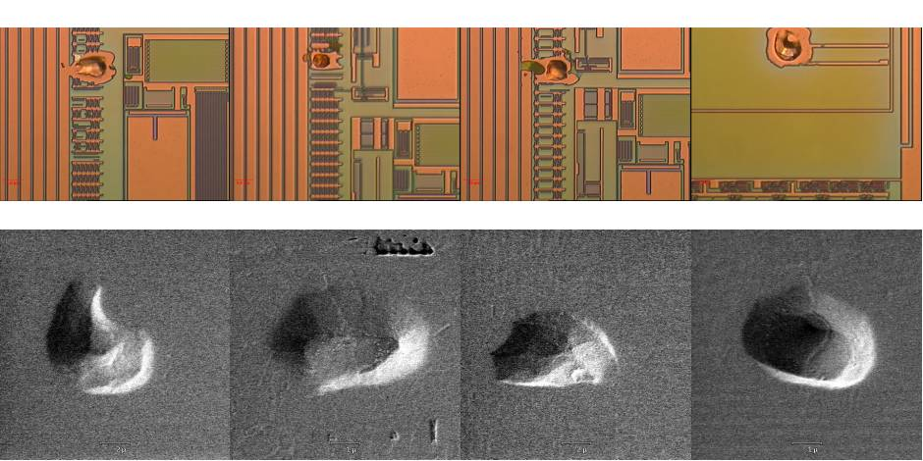
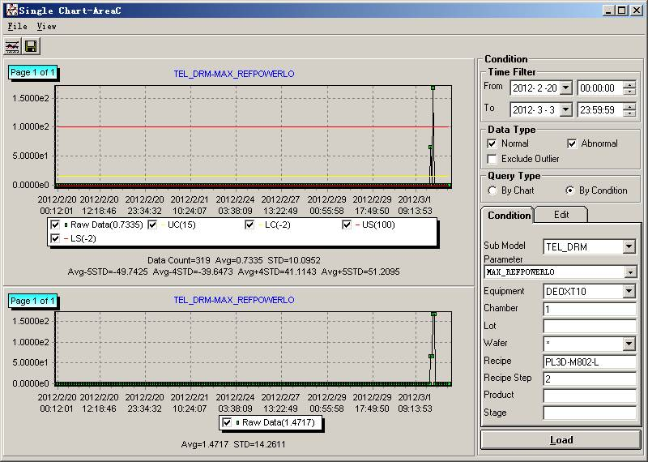
Case 11: S1 D13 SCCM M1SIN_RM Arcing
Issue description:
2012-3-2 D30258 suffer arcing defect issue from DEOXT10_A
Root cause:
1.High power etch recipe Max RF reflected power have jump
2.Top match failure induced
Solution:
1.Add Max RF reflected power stop tool chamber recovery SOP to prevent arcing defect
2.Change new top match

Slide 4
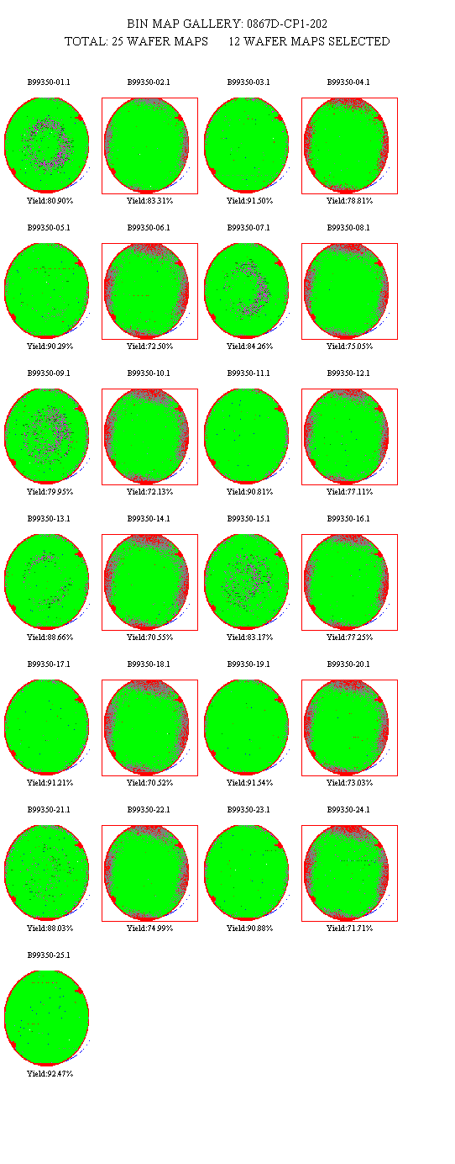
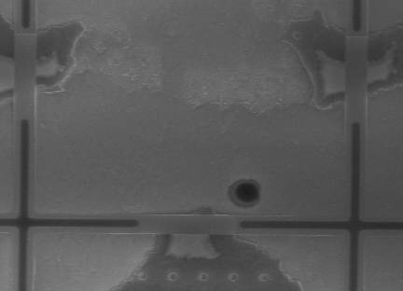
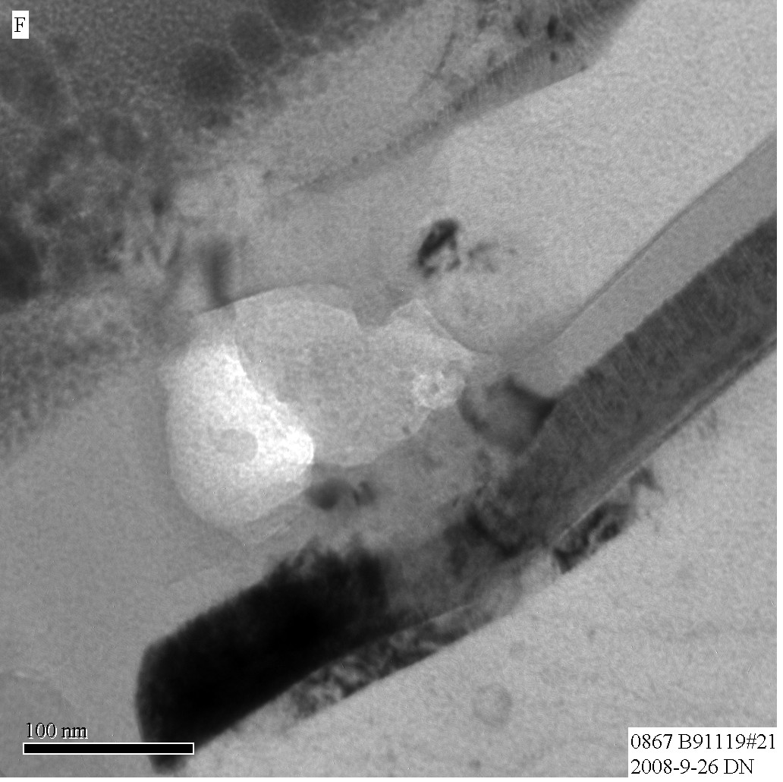
Case 12: F7 EMAX 35EE MIM structure arcing
Issue Description:
From March/2008, 35EE/0867 and 18EE/1756 square pattern fail getting worse and about 8% lots suffer MIM PID fail.
PFA shows hole exists at MIM when force high voltage, suspected PID issue
PFA delayer found hole@MIM
when force high voltage
CP MAP square pattern fail
VIA4
IMD4
DARC
MIM TOP METAL
PEOX 380A
Bottom Metal (M4)

Slide 5
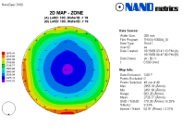
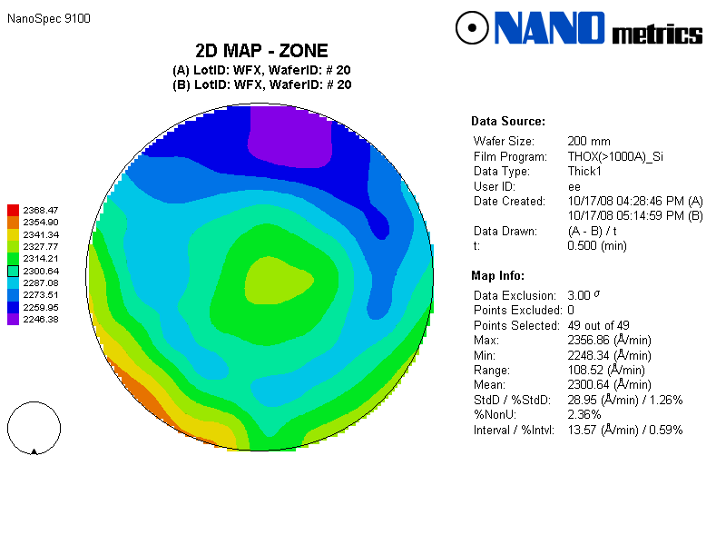
Case 12: F7 EMAX 35EE MIM structure arcing
Root Cause:
MIM structure is easy to collect electron and electron current will induce arcing.
Solution:
Remove VIA etch OE step magnet from 30Gauss to 0.
VIA4-ET 30G E/R MAP
VIA4-ET 0G E/R MAP
Channel 3
Channel 2
Channel 4
Channel 1
CP MAP
Configurable Magnetic Field (CMF)
CP MAP matches with VIA4-ET ER map and tool configure
W/E ET faster than center, 0G condition WE ER lower than 30G condition

Slide 6
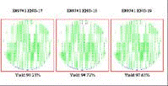
Case 13: B1 55nm MX AIO WC Micro Arcing
Issue Description:
RDA55nm 3712/4035 total 5pcs suffered wafer center micro arcing issue at MX-ET, by wafer defect impact ratio about 3%.
Suspect Model:
Not clear, suspect recipe transition step is not smooth.
Solution:
Optimize recipe: (soft pin + high pressure de-chuck + lower chucking voltage + plasma ramp up).

Slide 7
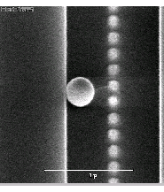
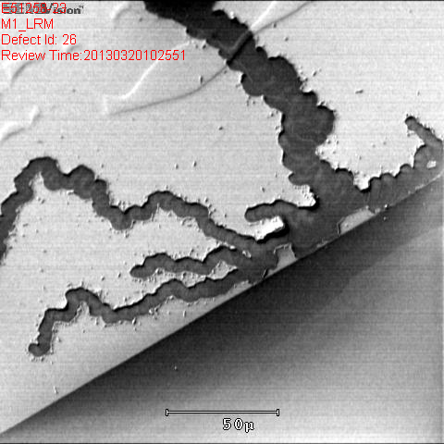
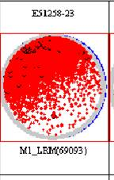
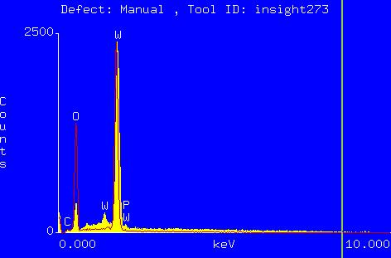
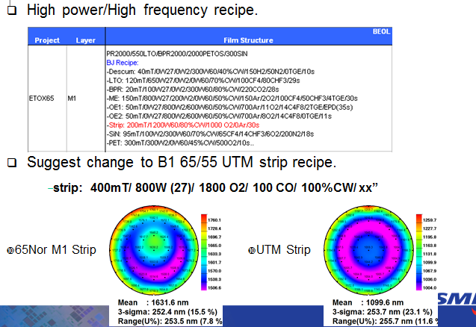
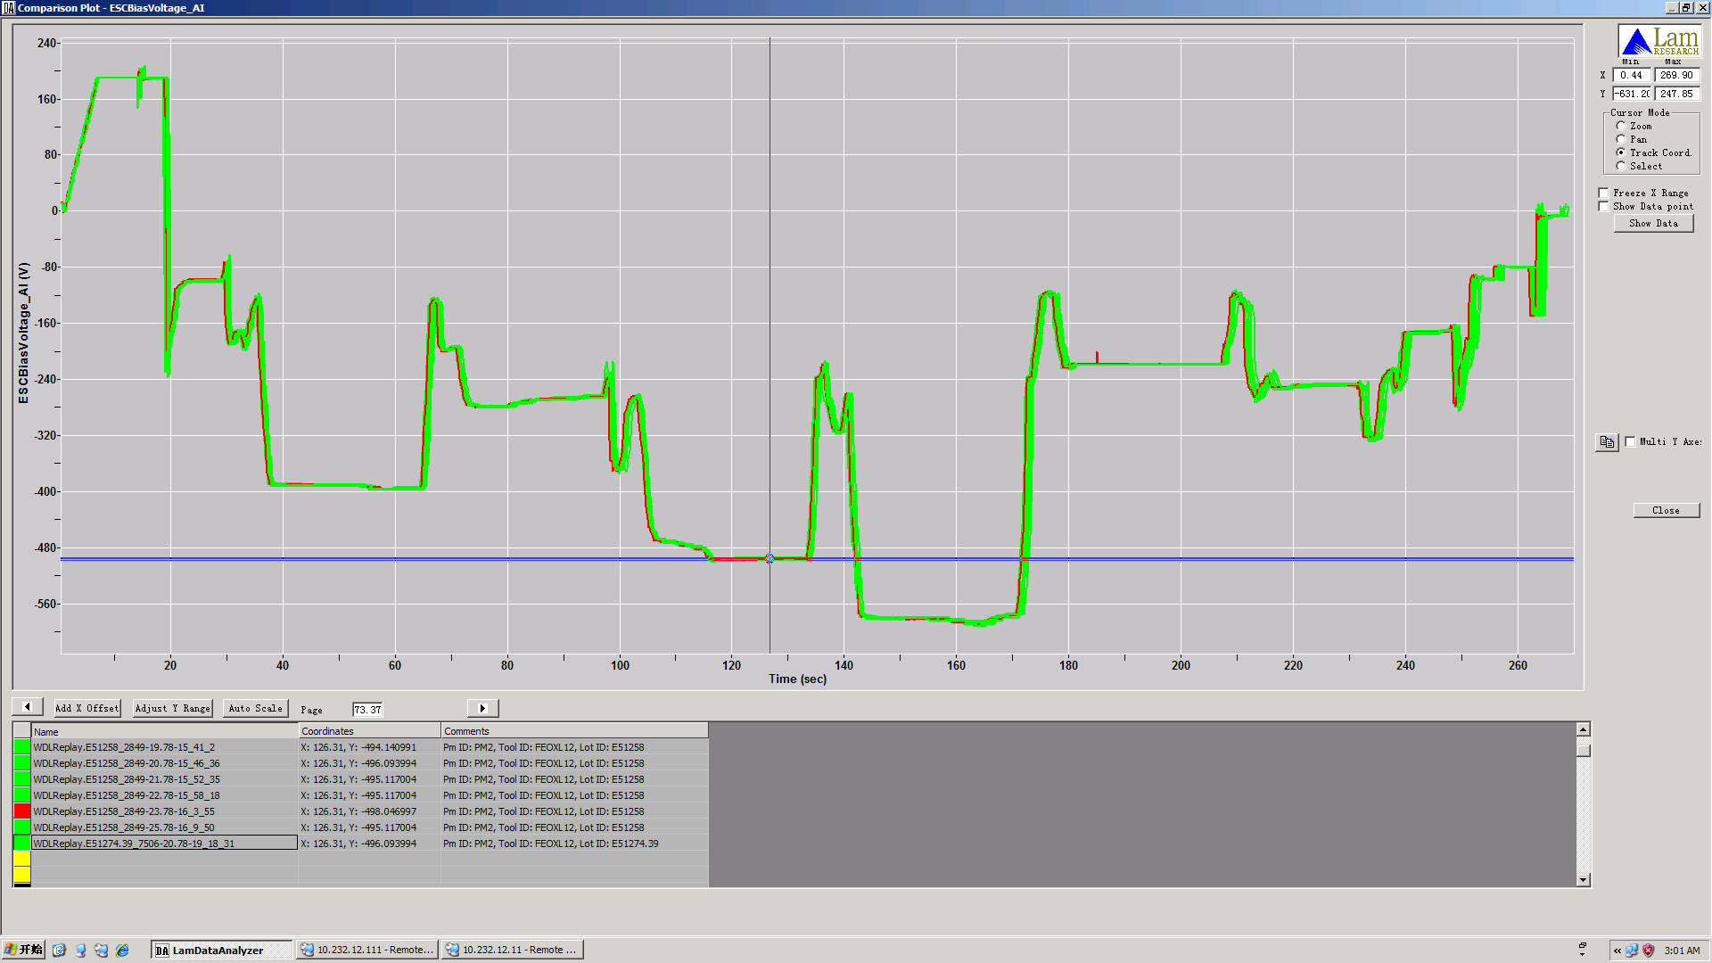
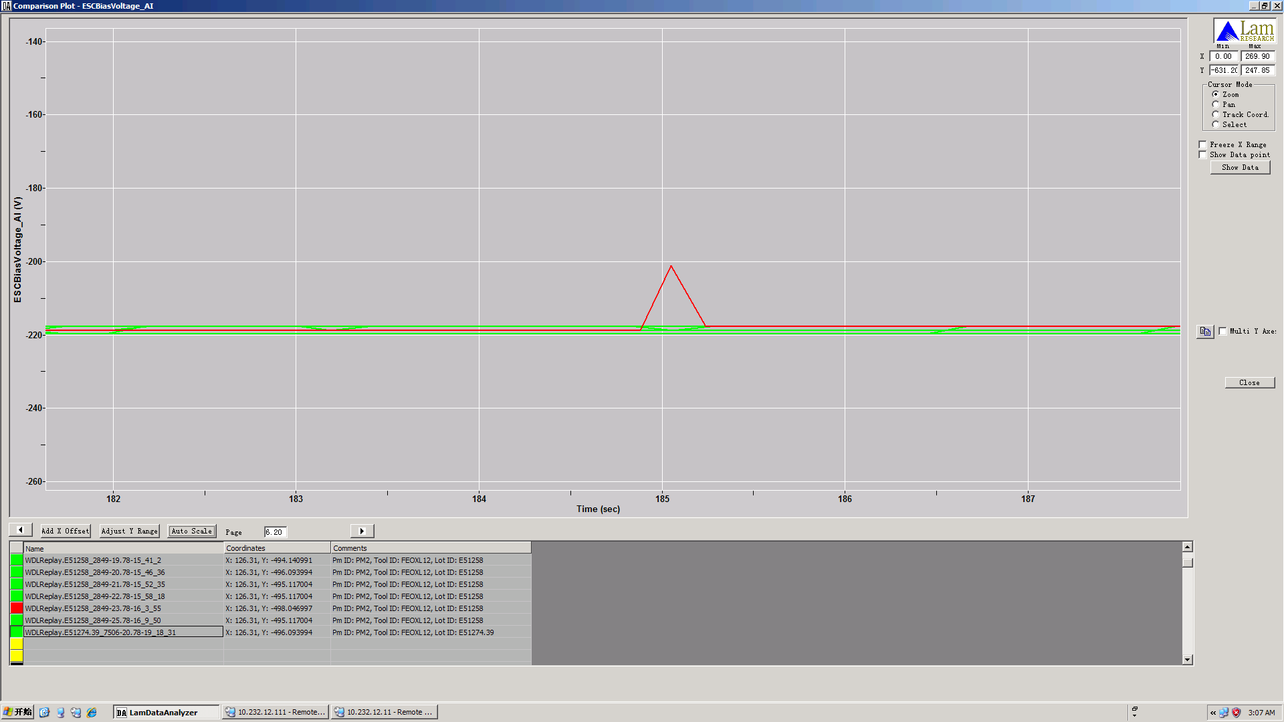
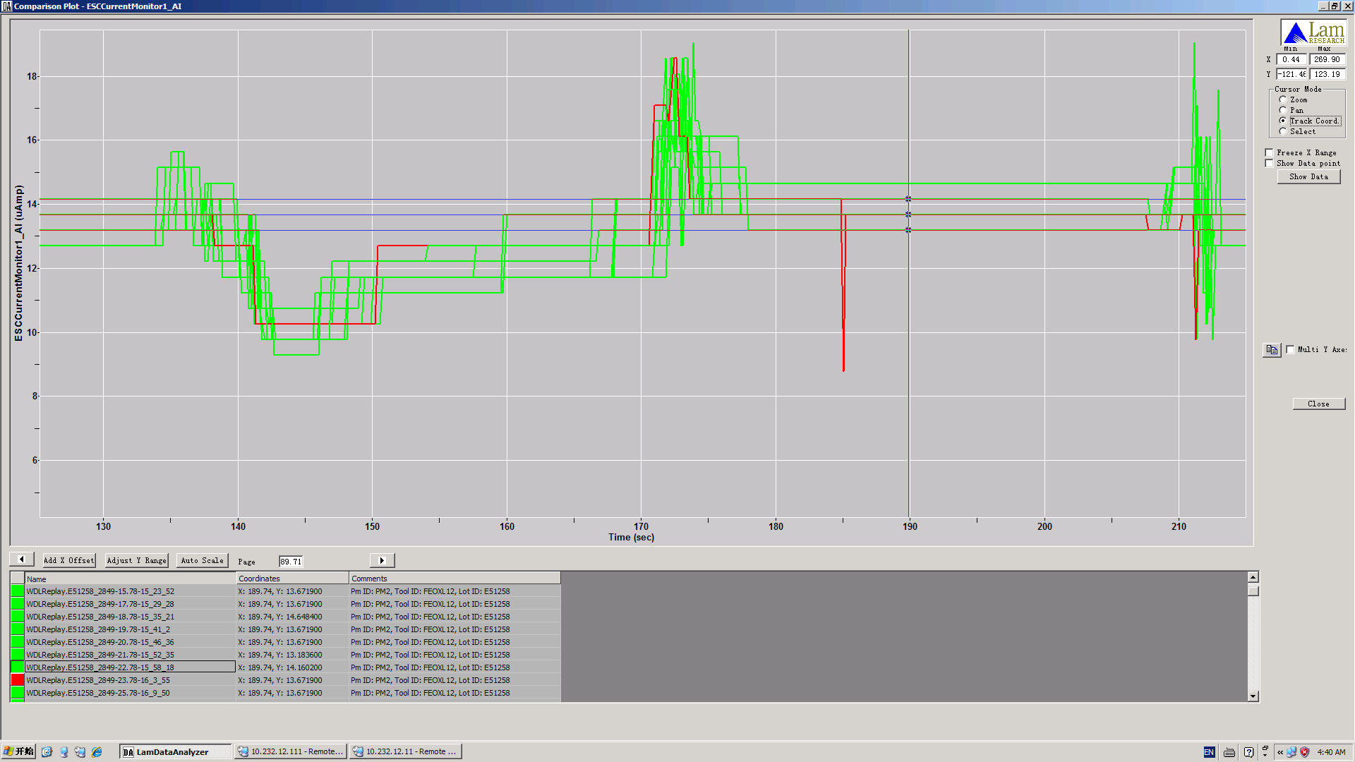
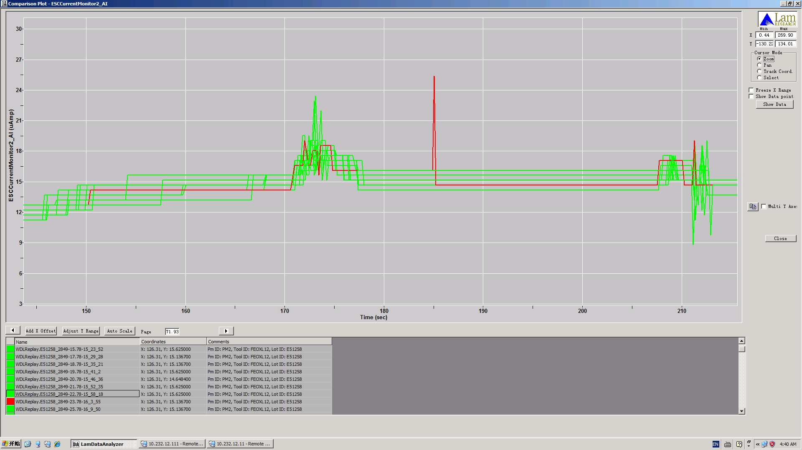
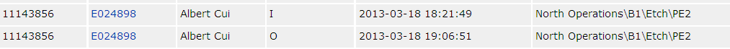
Case 14: B1 65Nor M1 Arcing
Issue Description :
On 3-19, FEOXL12_B ,5081 E51258#23@M1OX-ET suffered arcing defect, chamber RF hour:180hrs.
Root Cause: 1. Suspect WEE CTW remain cause plasma arcing
2. 60MHz strip high power plasma not stable
Solution:
1. Inform PIE/TF help stop and check ETWDP01-A.
2. Qualify new strip recipe.
W
ESC bias voltage
Zoom in
ESC current1
ESC current2

Slide 8
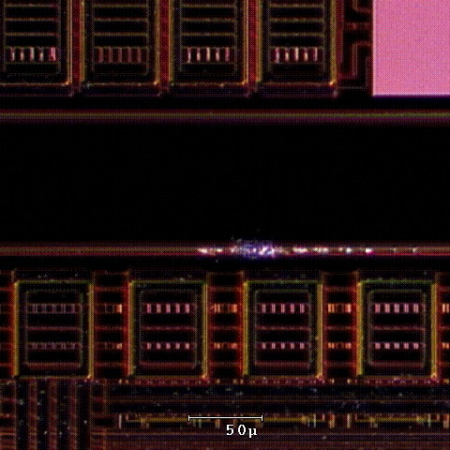
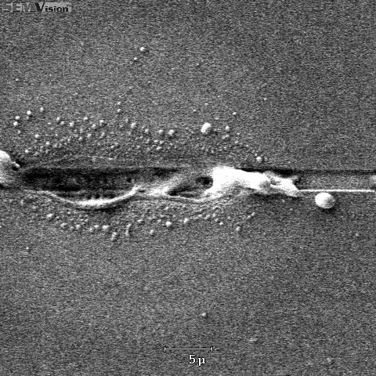
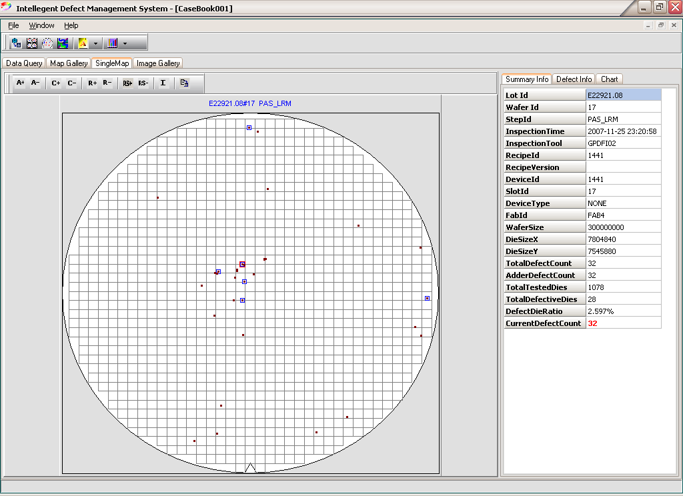
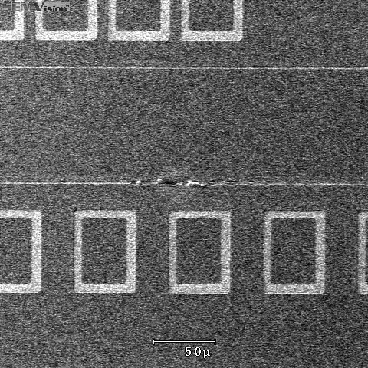
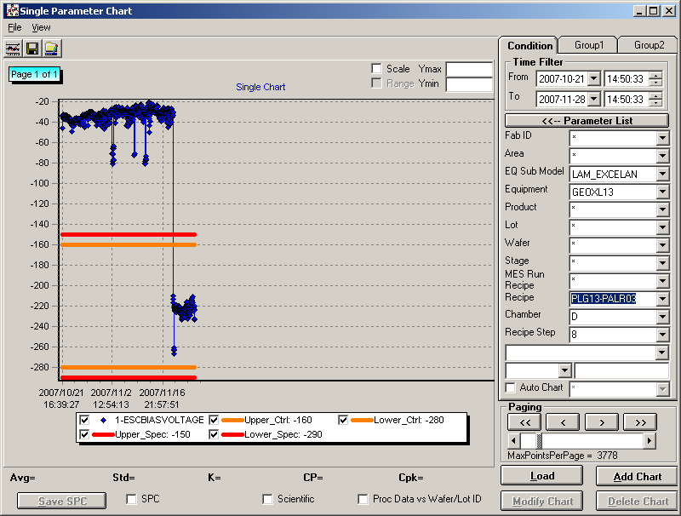
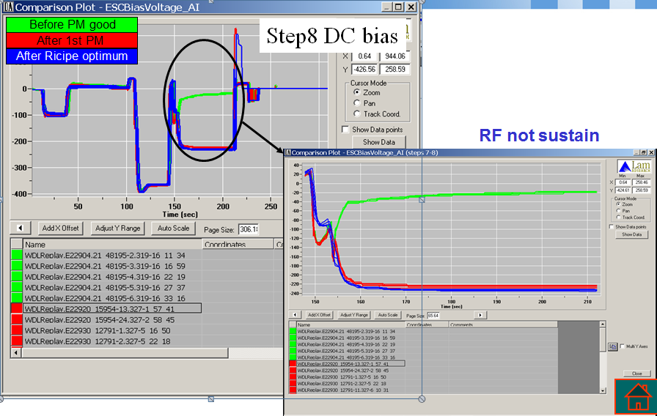
Case 15: B1 L13 PAS LRM Arcing
Issue Description:
GEOXL13_D release L13 PAS1-LRM on 9-27.
11-21 Do 1st cycle wet clean
After chamber recover, step8 IEMS ESC BIAS Voltage drop from –20 to –240, inline defect scan find arcing issue, in wafer center area, source is seal ring. 11-23
Root cause analysis:
Chamber condition shift. 1st cycle chamber condition maybe is not a normal condition.
Recipe margin.
Solution:
Optimize recipe.

Slide 9
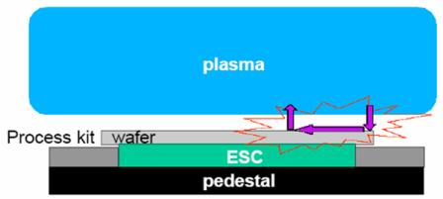
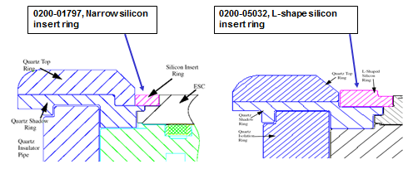
Case 16: B1 eMax PAS2 Arcing
Issue description:
Frequently down possible arcing, Almost all applications suffered this issue including PA203 (No TiN cap), PA204(TiN cap), TD WV Pad2 (TiN cap), etc. Always happened at wafer edge in seal ring area.
Root cause:
Suspect ALFx or TiFx particle disturbance and fall between wafer edge and SI ring from Quartz ring and induce plasma spiking(arcing).
Solution:
L shape ring + dry clean + season+ fine tune ESC voltage + fine tune B/H pressure

